Slide 1
Software Design Document
CS 4391-01

Slide 2
UML Diagrams
Behavioral UML Diagram
Activity Diagram
Use Case Diagram
Interaction Overview Diagram
Timing Diagram
State Machine Diagram
Communication Diagram
Sequence Diagram
Structural UML Diagram
Class Diagram
Object Diagram
Component Diagram
Composite Structure Diagram
Deployment Diagram
Package Diagram
Profile Diagram

Slide 3
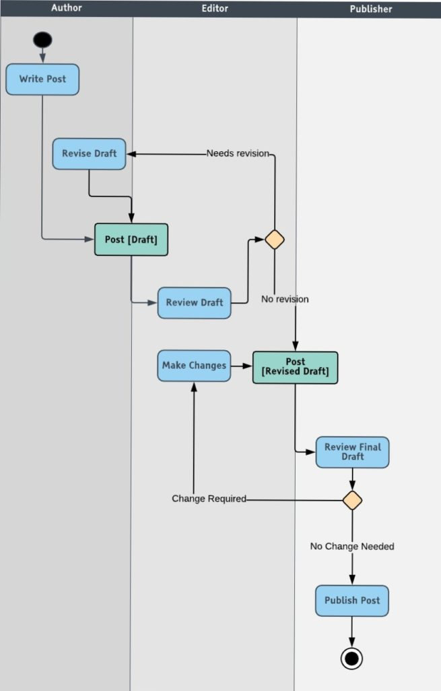
Activity Diagrams
Generally used to describe the flow of different activities and actions.
These can be both sequential and in parallel.

Slide 4
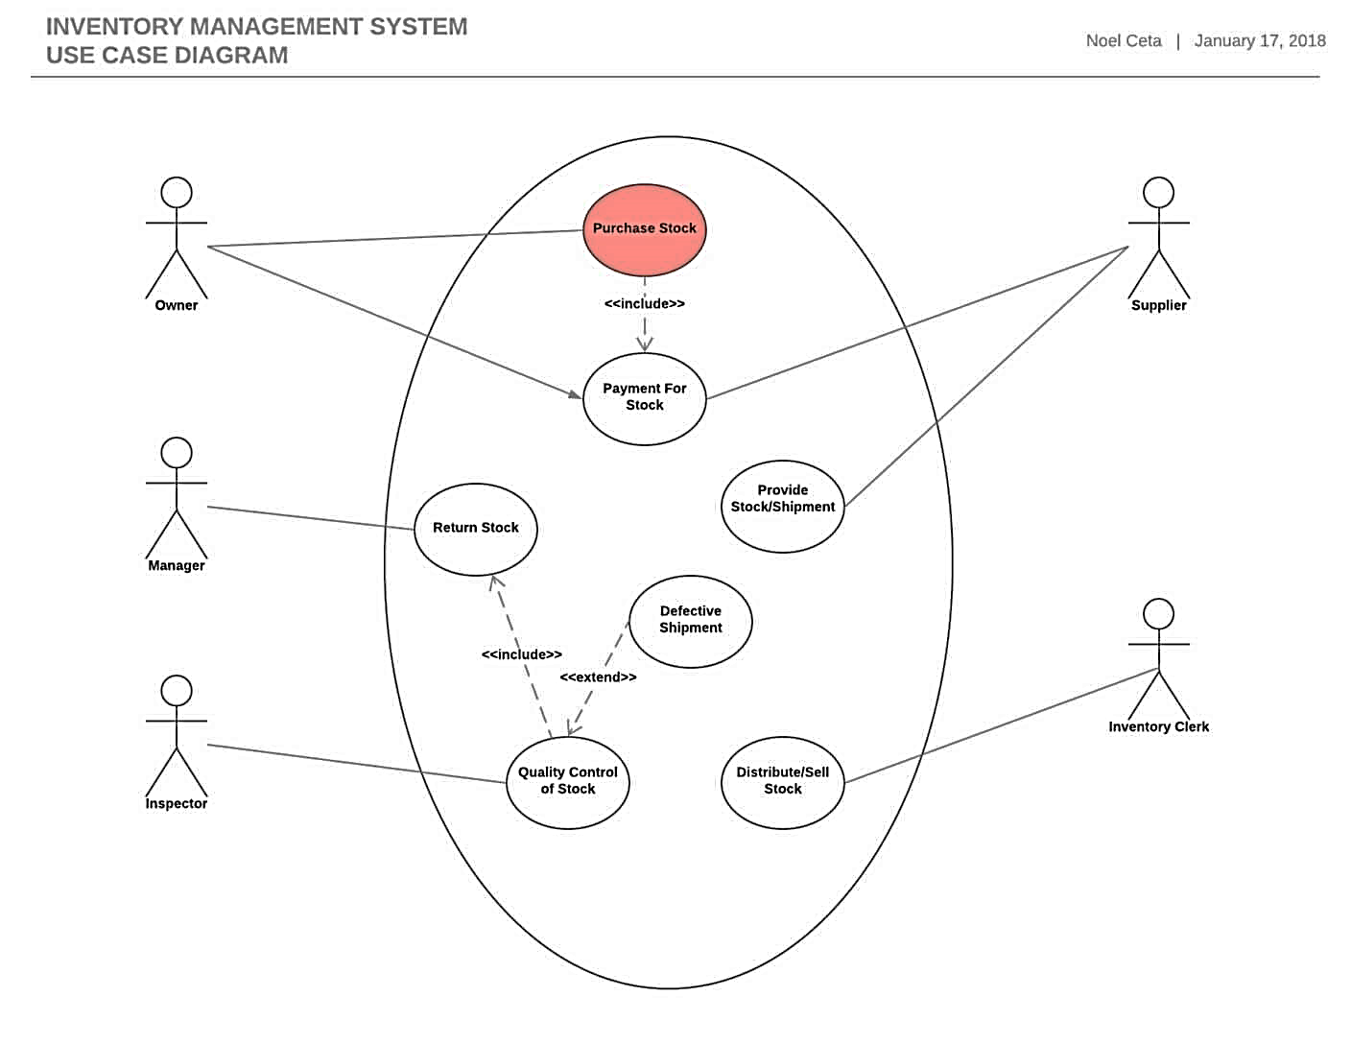
Use Case Diagram
To analyze the system’s high-level requirements.
Requirements expressed through different use cases.
Three main components of this UML diagram:
Functional requirements – represented as use cases; a verb describing an action
Actors – they interact with the system; an actor can be a human being, an organization or an internal or external application
Relationships between actors and use cases – represented using straight arrows

Slide 5
Interaction Diagrams
A subset made of four diagrams, called Interaction Diagrams:
Interaction Overview Diagram
Timing Diagram
Sequence Diagram
Communication Diagram
An activity diagram, with the addition of elements such as interaction, interaction use, time constraint, duration etc.

Slide 6
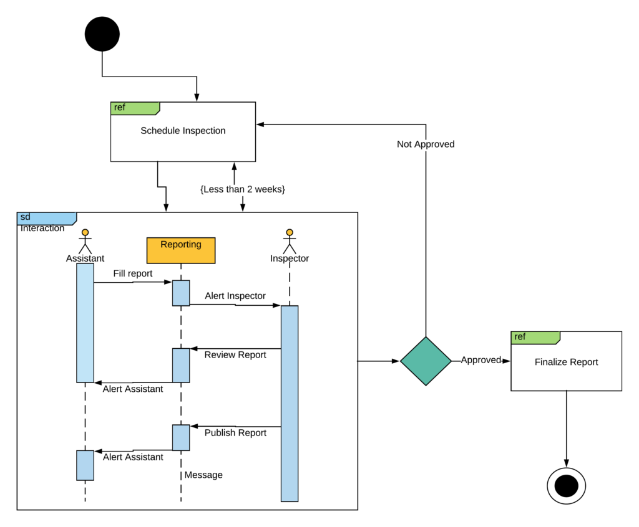
Interaction Diagrams

Slide 7
Timing diagram
To represent the relations of objects when the center of attention rests on time
How objects and actors act along a linear time axis.
Main components:
Lifeline – individual participant
State timeline – a single lifeline can go through different states within a pipeline
Duration constraint – a time interval constraint that represents the duration necessary for a constraint to be fulfilled
Time constraint – a time interval constraint during which something needs to be fulfilled by the participant
Destruction occurrence – a message occurrence that destroys the individual participant and depicts the end of that participant’s lifeline

Slide 8
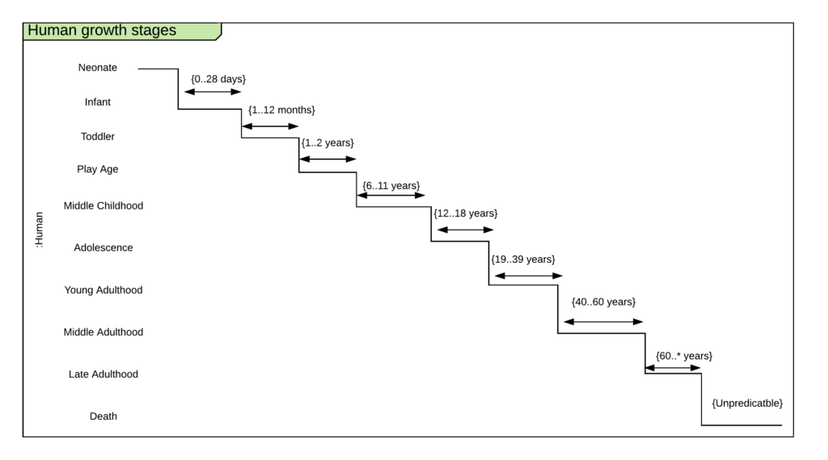
Timing Diagram

Slide 9
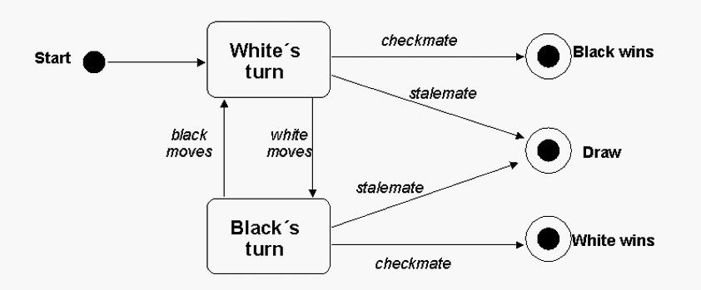
State Machine UML diagram
To describe the different states of a component within a system.

Slide 10
Sequence UML Diagram
Describe the sequence of messages and interactions that happen between actors and objects.
Actors or objects can be active only when needed or when another object wants to communicate with them.
All communication is represented in a chronological manner.

Slide 11
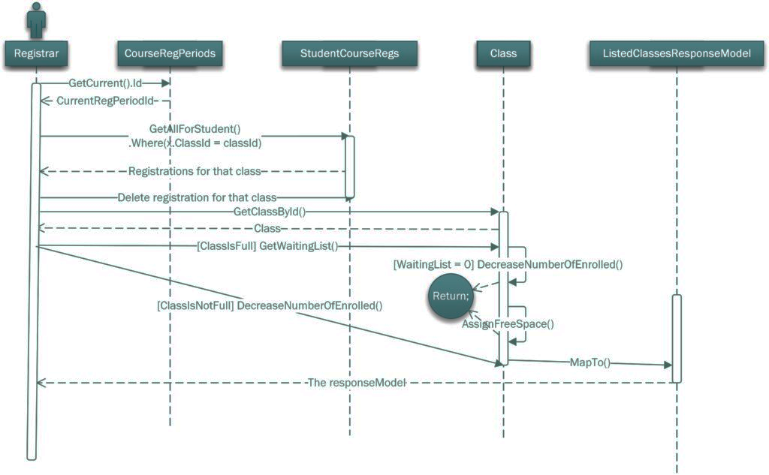
Sequence UML Diagram

Slide 12
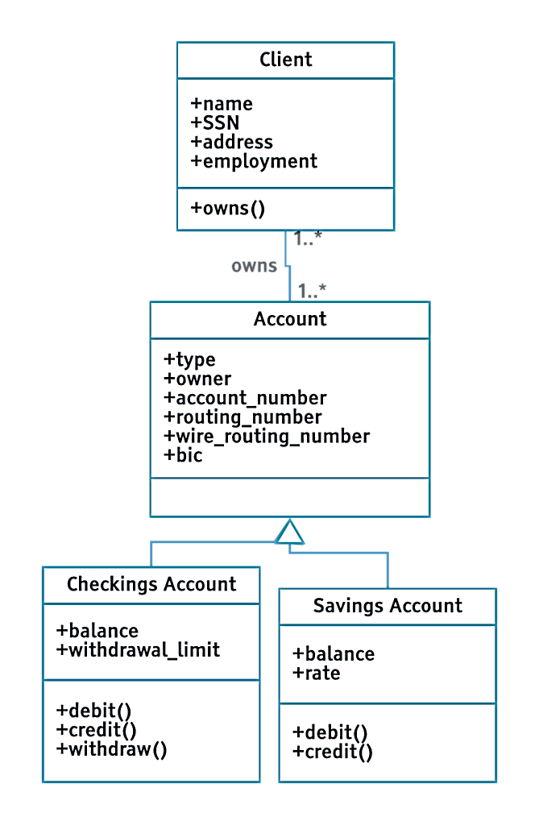
Class Diagram
Each class has 3 fields:
The class name at the top,
The class attributes right below the name,
The class operations/behaviors at the bottom.

Slide 13
Relationships in Class Diagrams
Relationships in class diagrams include different types of logical connections.
The following are such types of logical connections that are possible in UML:
Association
Directed Association
Reflexive Association
Multiplicity
Aggregation
Composition
Inheritance/Generalization

Slide 14
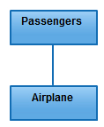
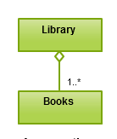

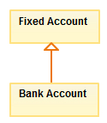
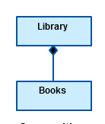
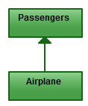
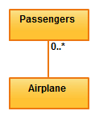
Relationships in Class Diagrams
Association
Reflexive Association
Aggregation
Inheritance / Generalization
Directed Association
Multiplicity
Composition

Slide 15
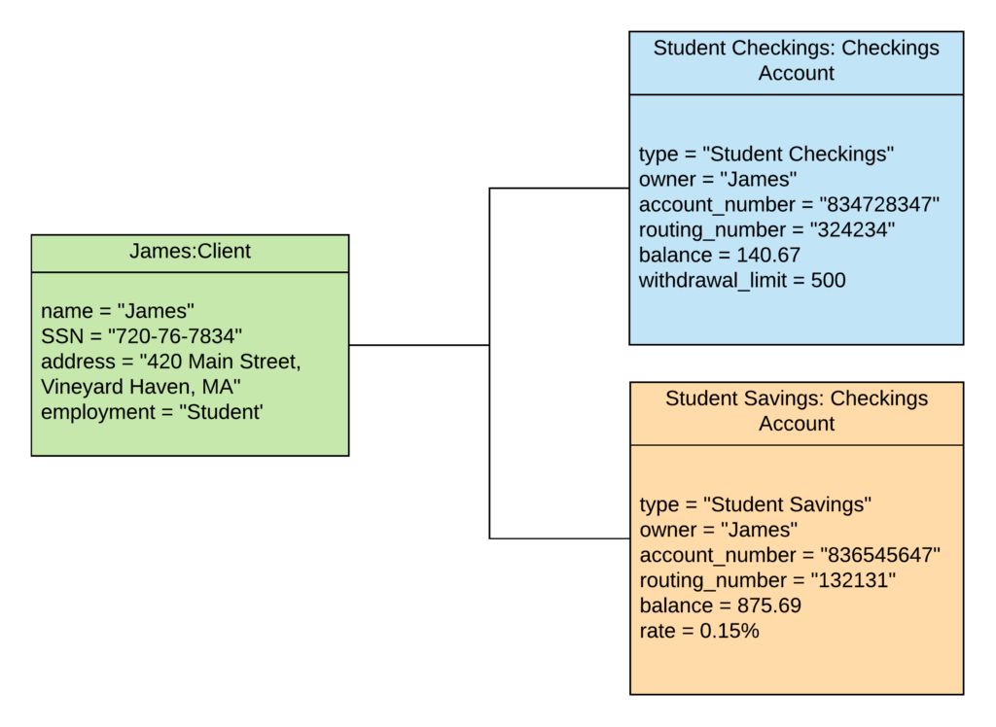
Object Diagram

Slide 16
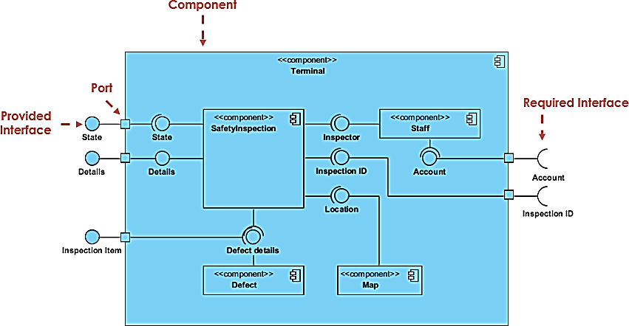
Component Diagram

Slide 17

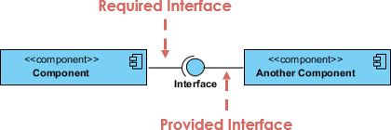

Component Diagram: Basic Concepts
A component
Interface
Port

Slide 18
ER Diagram: Entity Relationship Diagram Model
Displays the relationship of entity sets stored in a database.
Help to explain the logical structure of databases.
ER diagrams are created based on three basic concepts: entities, attributes and relationships.
Use rectangles to represent entities, ovals to define attributes and diamond shapes to represent relationships.

